Slide 1

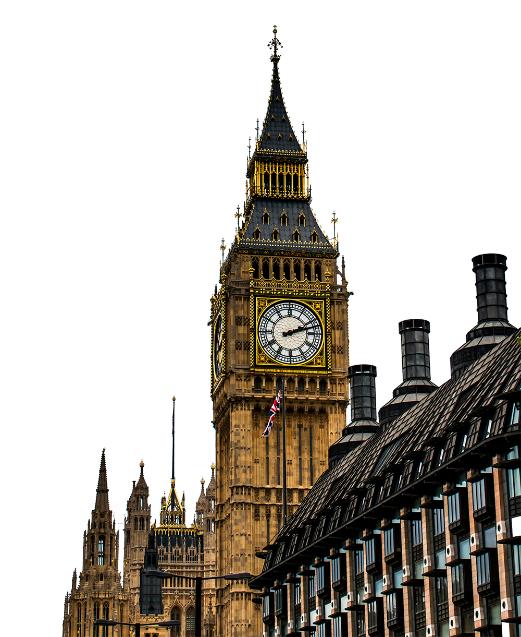
Welcome to
LON
DON

Slide 2



Total Population
9M
LON
Welcome to
DON
This city has a rich history dating back over 2.000 years
Capital of
ENGLAND
and the
UNITED KINGDOM

Slide 3




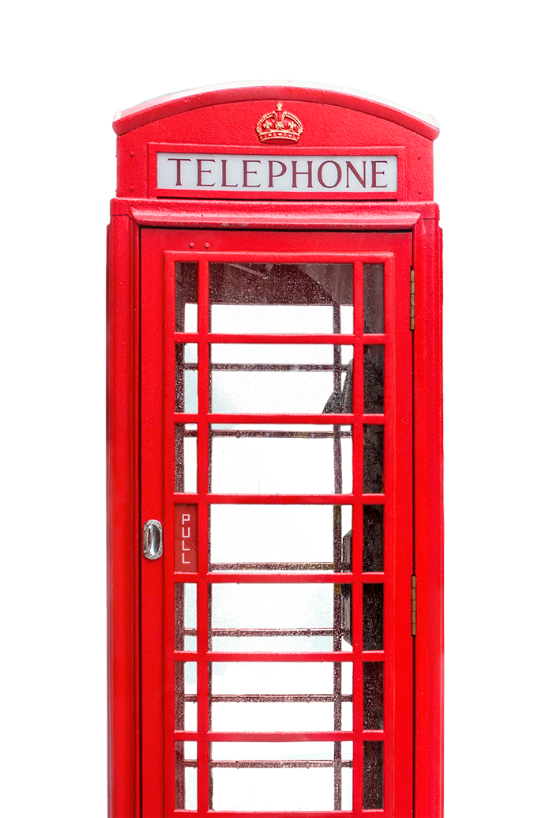

LON
ROYALTY
DON
Culture
This city has a rich history dating back over 2.000 years
Total Population
9M
London is the capital city of England and the United Kingdom. It is a global city and one of the world's most populous and diverse cities, with a rich history dating back over 2,000 years.
Capital of
ENGLAND
and the
UNITED KINGDOM
It's worth noting that many public phones in London are located inside red phone boxes, which have become iconic symbols of the city.

Slide 4
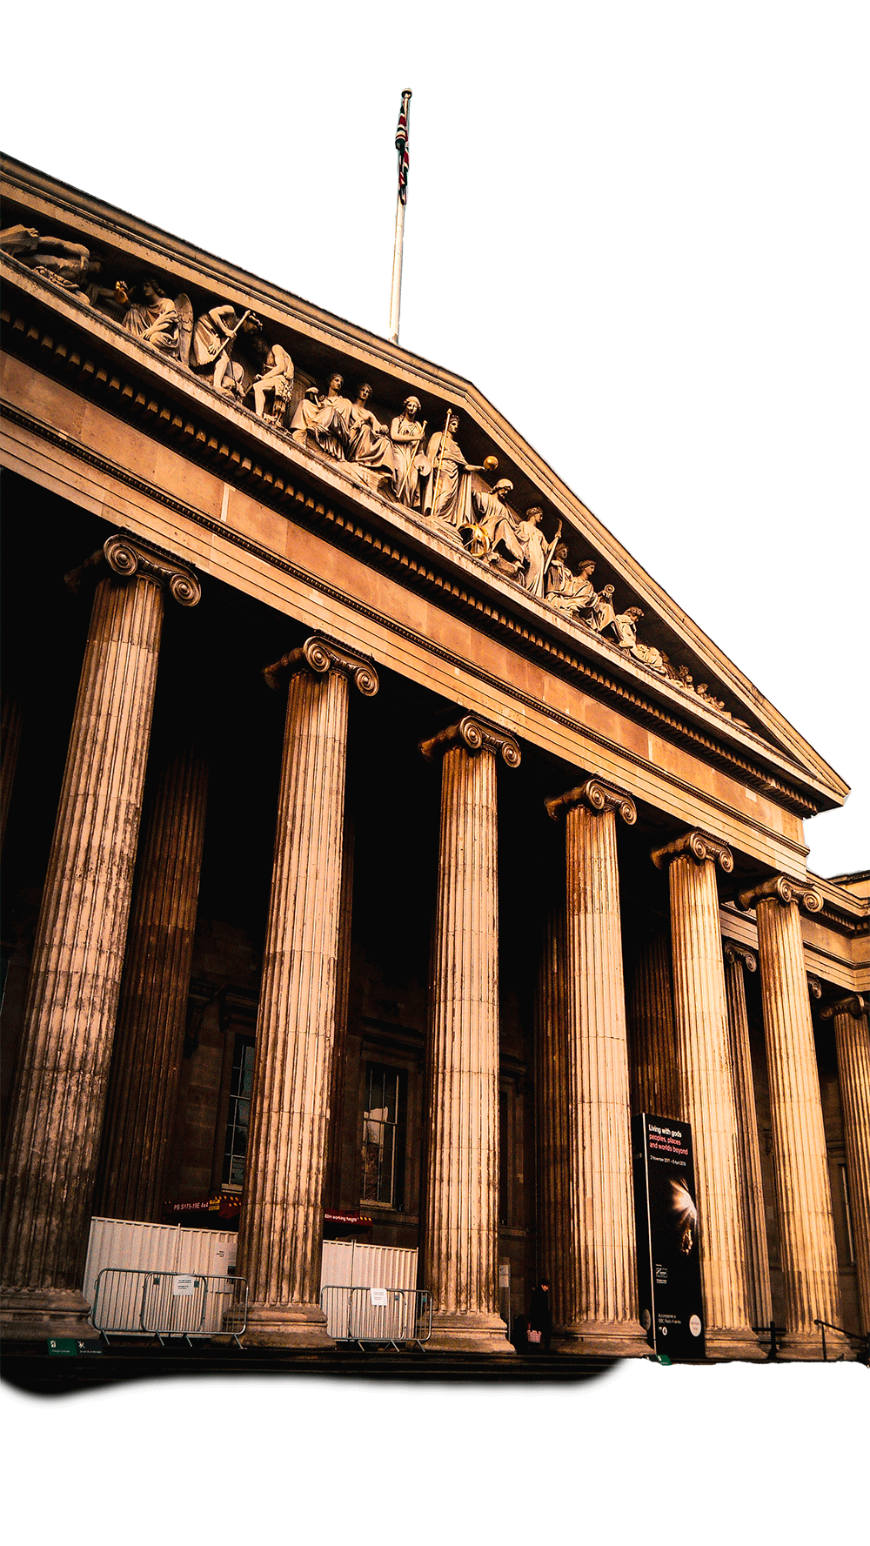
This city has a rich history dating back over 2.000 years
Total Population
9M
Capital of
ENGLAND
and the
UNITED KINGDOM
ROYALTY
BUCKINGHAM
Culture
Palace
It's worth noting that many public phones in London are located inside red phone boxes, which have become iconic symbols of the city.
The official residence of the British monarch, with changing of the guard ceremonies and public tours available.

Slide 5
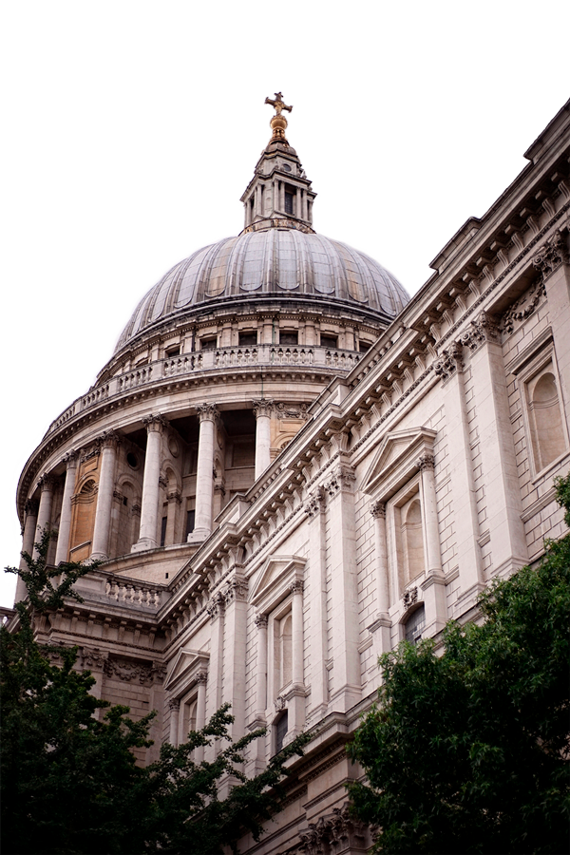
SAINT PAUL’S
BUCKINGHAM
Cathedral
Palace
The official residence of the British monarch, with changing of the guard ceremonies and public tours available.

Slide 6
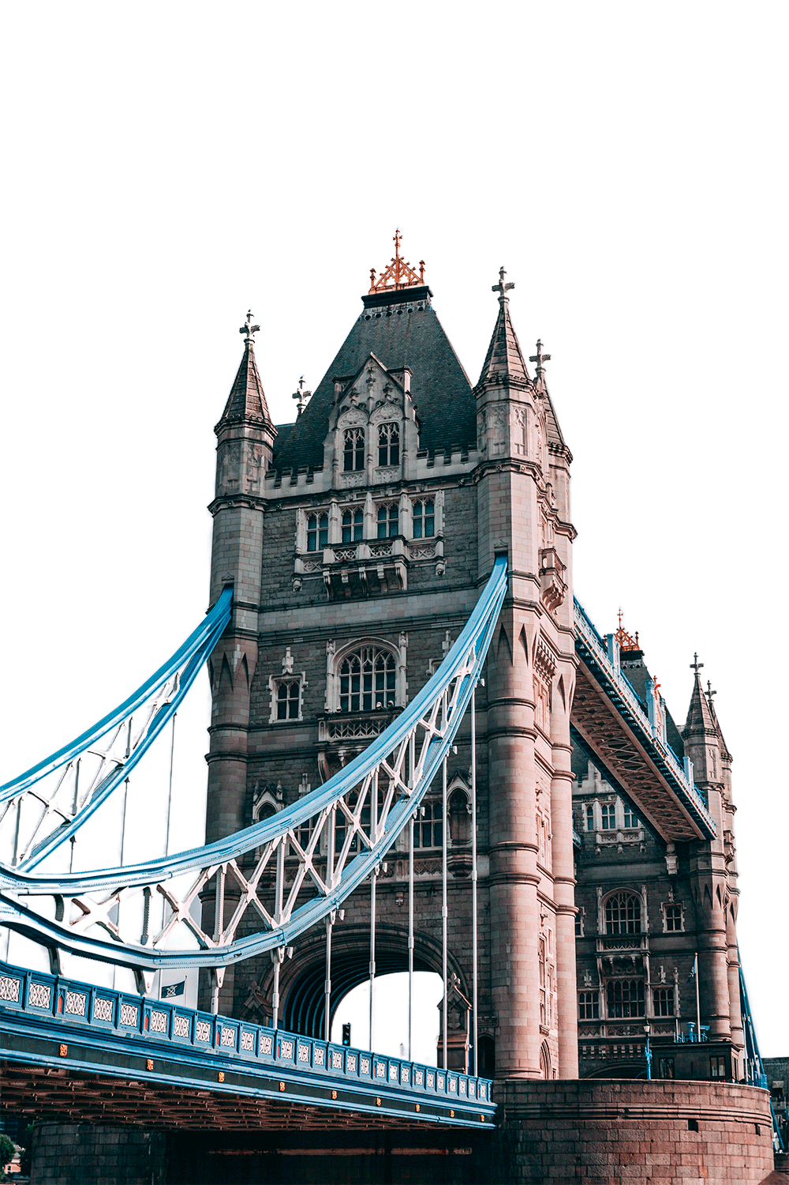
SAINT PAUL’S
TOWER
SAINT PAUL’S
Cathedral
Bridge
A historic and iconic cathedral with impressive architecture and stunning views from the dome.
Tower Bridge is an iconic suspension bridge located in central London, spanning the River Thames.

Slide 7

THANKS FOR
TOWER
Bridge
Tower Bridge is an iconic suspension bridge located in central London, spanning the River Thames.
watching

Slide 8
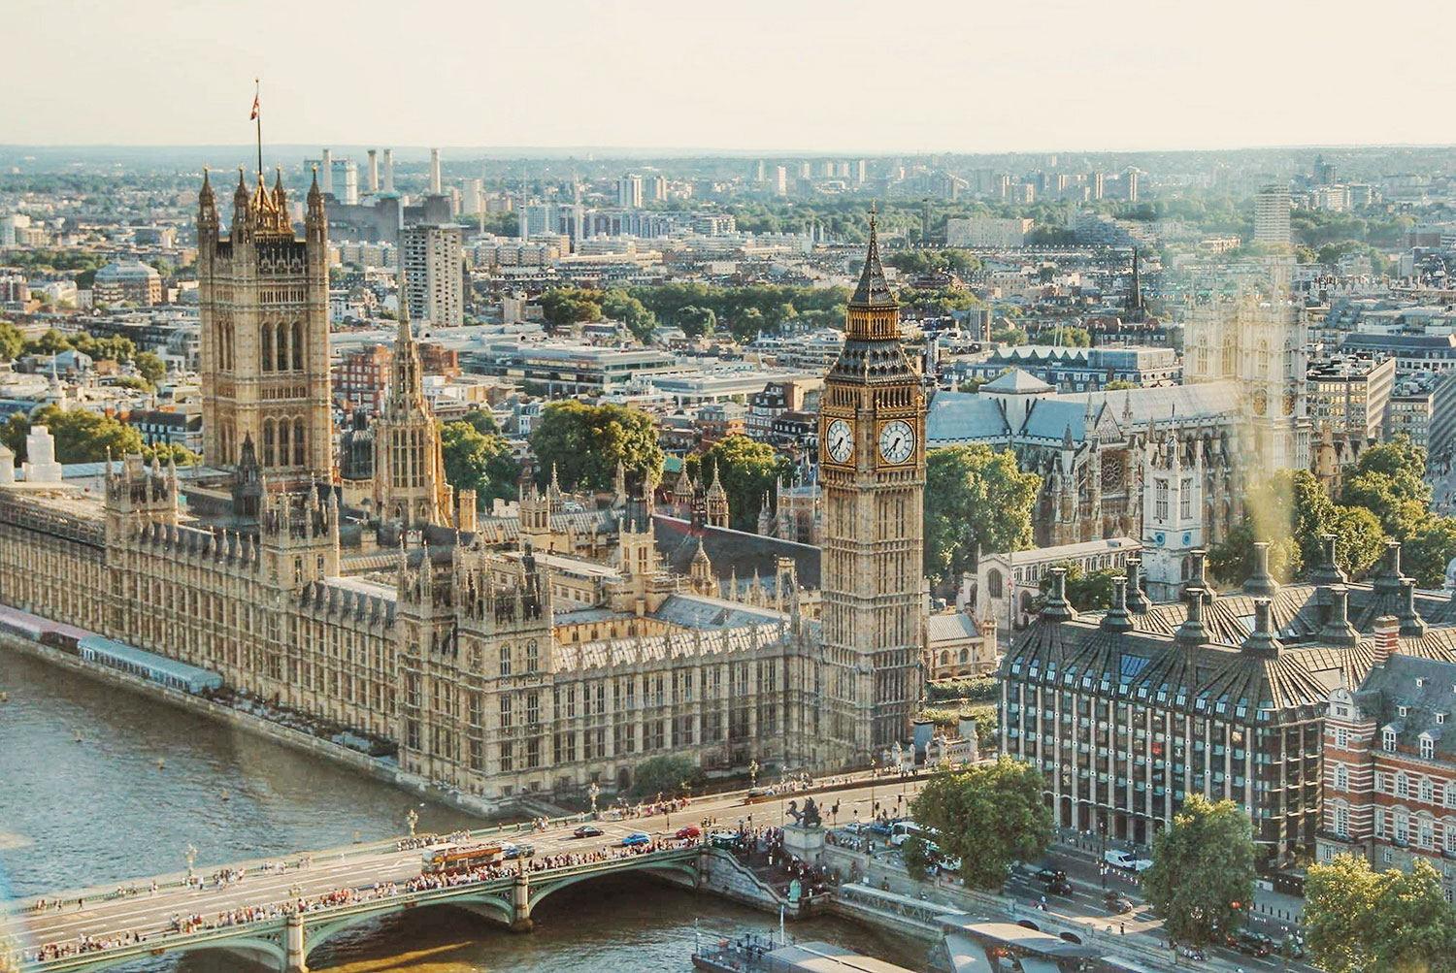
THANKS FOR
watching

